Slide 1
LOAN PREDICTION BASED
ON CUSTOMER BEHAVIOR
By
Dhruv Saldanha

Slide 2
INTRODUCTION
The dataset chosen for the project comprises of historical customer data, which will be used to train a predictive model for identifying potential loan defaulters.
The dataset includes a range of demographic, financial, and employment-related variables, as well as a target variable indicating loan default.

Slide 3
Project Motivation/Background
Business Question
Which customer will default on a loan ? Can we classify defaulters from non-defaulters and save money ?
Importance
Predicting loan default can help financial institutions manage risk and make informed lending decisions.
Disbursing a loan to a potential defaulter will cost the institution money; MONEY SAVED = MONEY EARNED
Brief Explanation
Loan default occurs when a borrower fails to repay their loan. Predictive models can assess the likelihood of default based on factors like income, age, and creditworthiness.
Effective prediction models can assist financial institutions in assessing the likelihood of loan default and making informed lending decisions.
Predictive analytics in this area can have significant social impact by promoting fair lending practices and financial inclusion while minimizing risk for both borrowers and lenders.

Slide 4
OBJECTIVE
The primary objective of mining the 'Loan Prediction Based on Customer Behavior' dataset is to address the business problem of predicting potential defaulters for a consumer loans product.
By analyzing features such as income, age, experience, marital status, house ownership, car ownership, profession, and location, the organization seeks to identify patterns and indicators that correlate with loan defaulting behavior.
The aim is to provide a reliable model for assessing the creditworthiness of new customers, aiding the organization in revenue generation.

Slide 5
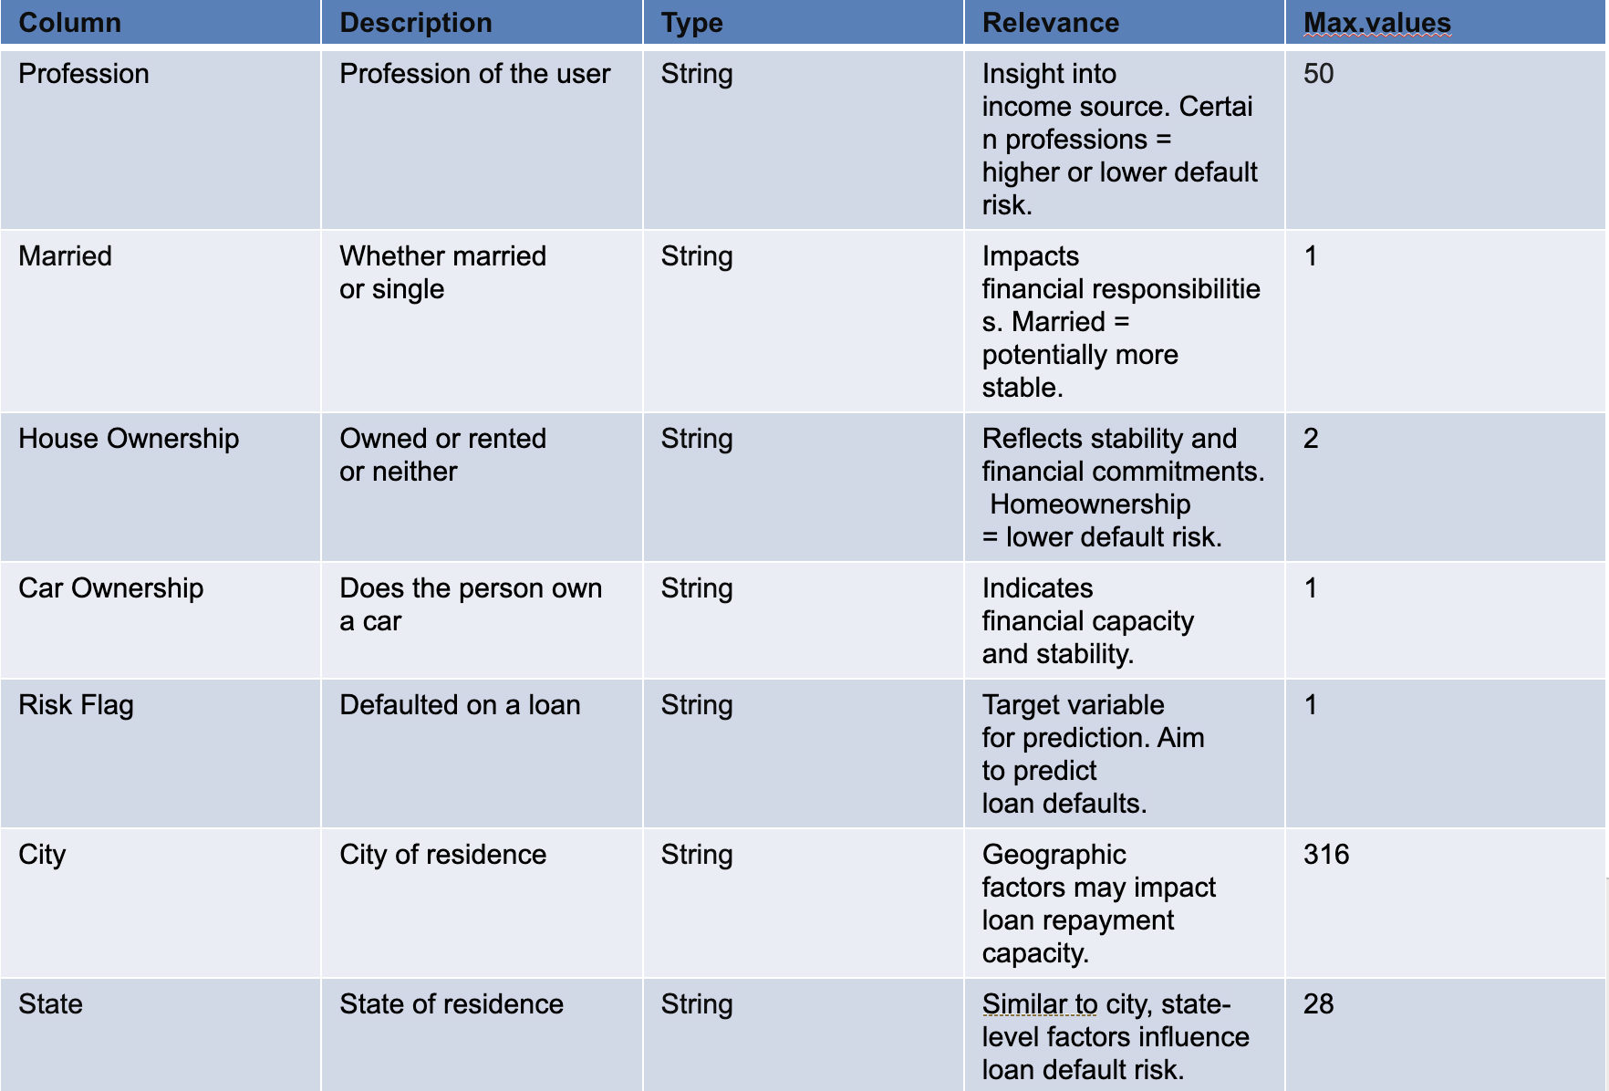
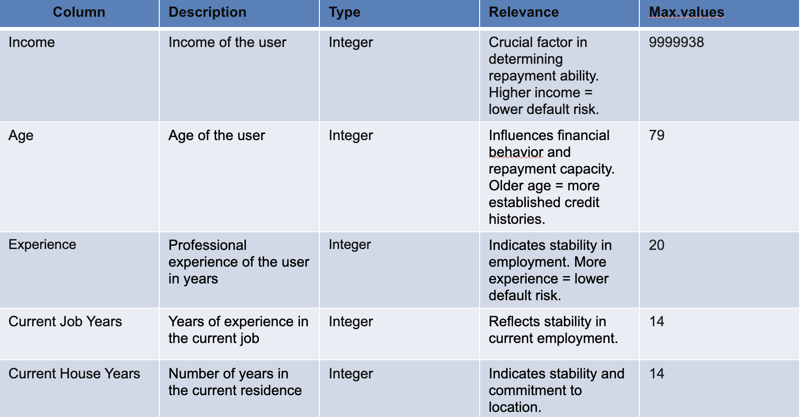
DATA DESCRIPTION
Categorical Type Variable​
Observations in the Data set: 252000
Number of Attributes: 13
Target Variable – Risk Flag
Continuous Type Variable​

Slide 6
Data analysis using visualization and findings
Feature Selection Techniques:
Evaluated three data preprocessing methods: Correlation-Based Simple Selection, Domain-Specific Feature Engineering, and Inclusive All Features approach, excluding only the ID.
Model Selection:
Utilized a suite of models including Logistic Regression, Gradient Boosting, Random Forest, XG-Boost, and Decision Tree to determine the influence of data preparation on predictive performance.
Preprocessing Focus:
Simple Preprocessing focused on directly correlated variables, Feature Engineering on created interactions, and the all-Features method took a comprehensive approach.
Performance Evaluation:
Generated performance metrics like ROC-AUC, Precision, Recall, F1-Score, and Confusion Matrix for comparative analysis of each preprocessing strategy's effectiveness.
Visual Analytics:
Employed bar charts for a clear visual representation of feature importance and ROC AUC scores, highlighting the superior performance of the Feature Engineering technique.

Slide 7
Libraries and Tools used for Data Analysis
Data Visualization
Tableau
Matplotlib
Seaborn
Data Manipulation and Wrangling
Numpy
Pandas
Model Building
Scikit-learn
Imblearn (Contains over sampling methods to deal with imbalanced data)

Slide 8
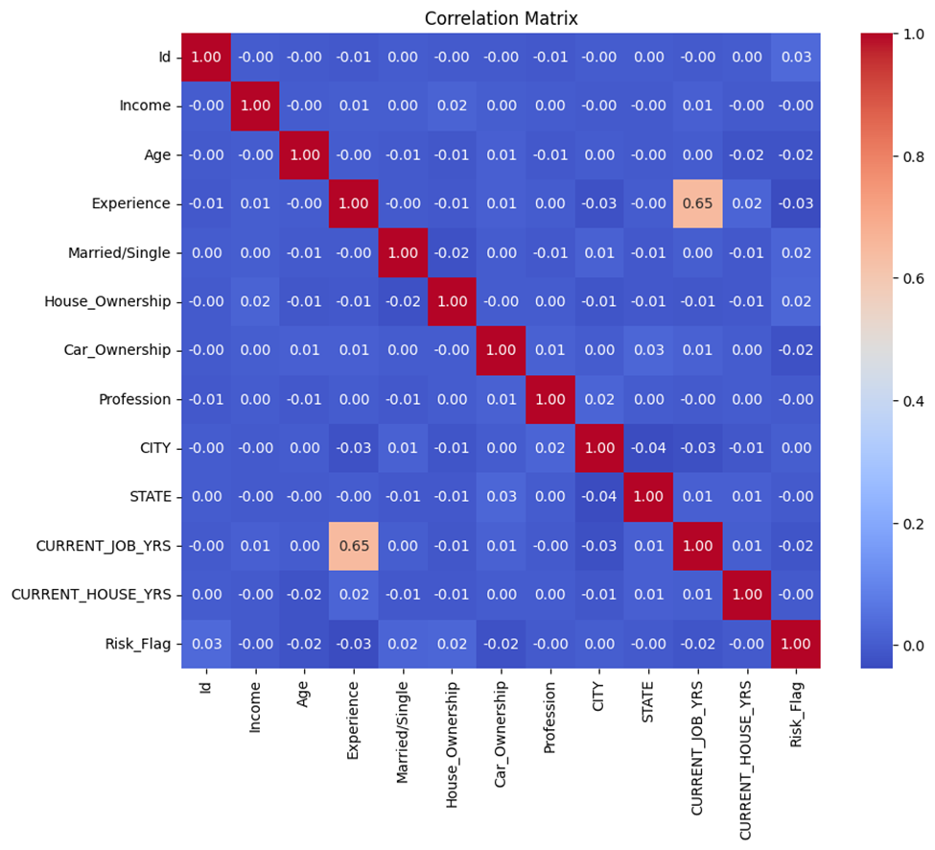
Feature Selection
Correlation-Based Simple Selection
For the Correlation matrix we pre-processed the data by cleaning and removing unwanted special characters
Encoded the categorical variables
Used SMOTE() for oversampling
We can clearly see that there does not exist any sort of linear correlation between the Target and Input variables

Slide 9
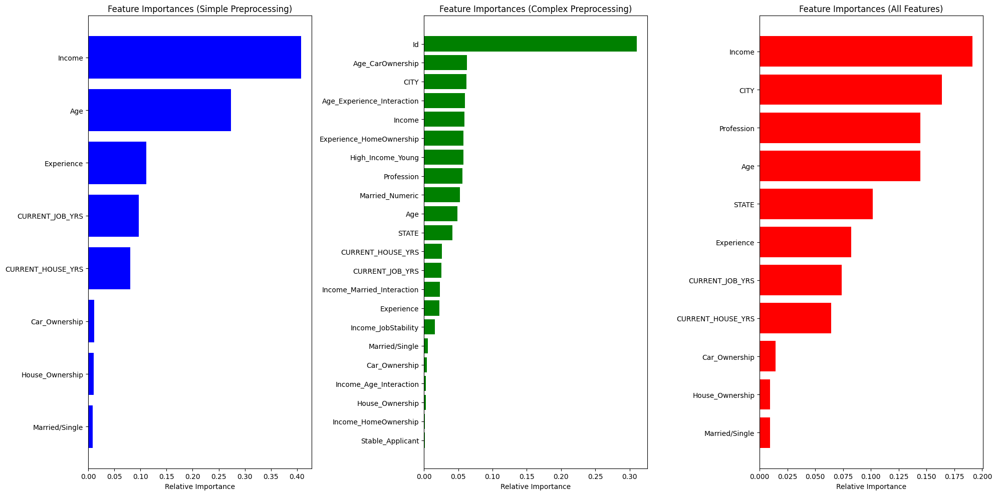
Feature Selection Contd.
Feature Importance using Random Forest Classifier

Slide 10
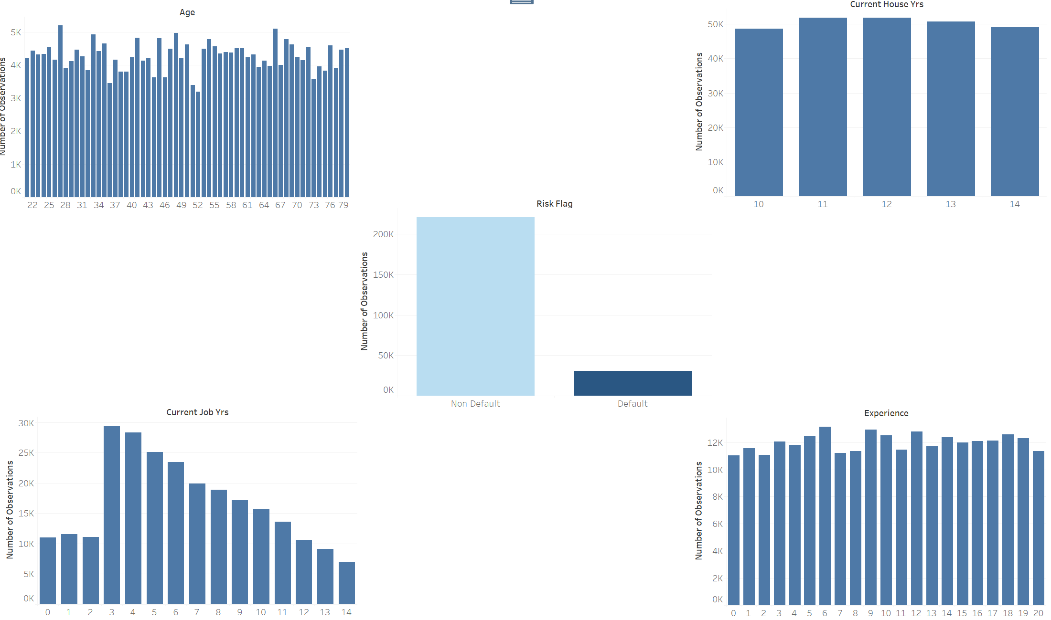
Visualizing Numerical Variables
This is a real-time dataset hence with any loan disbursement agency the number of non-defaulters > number of Defaulters

Slide 11
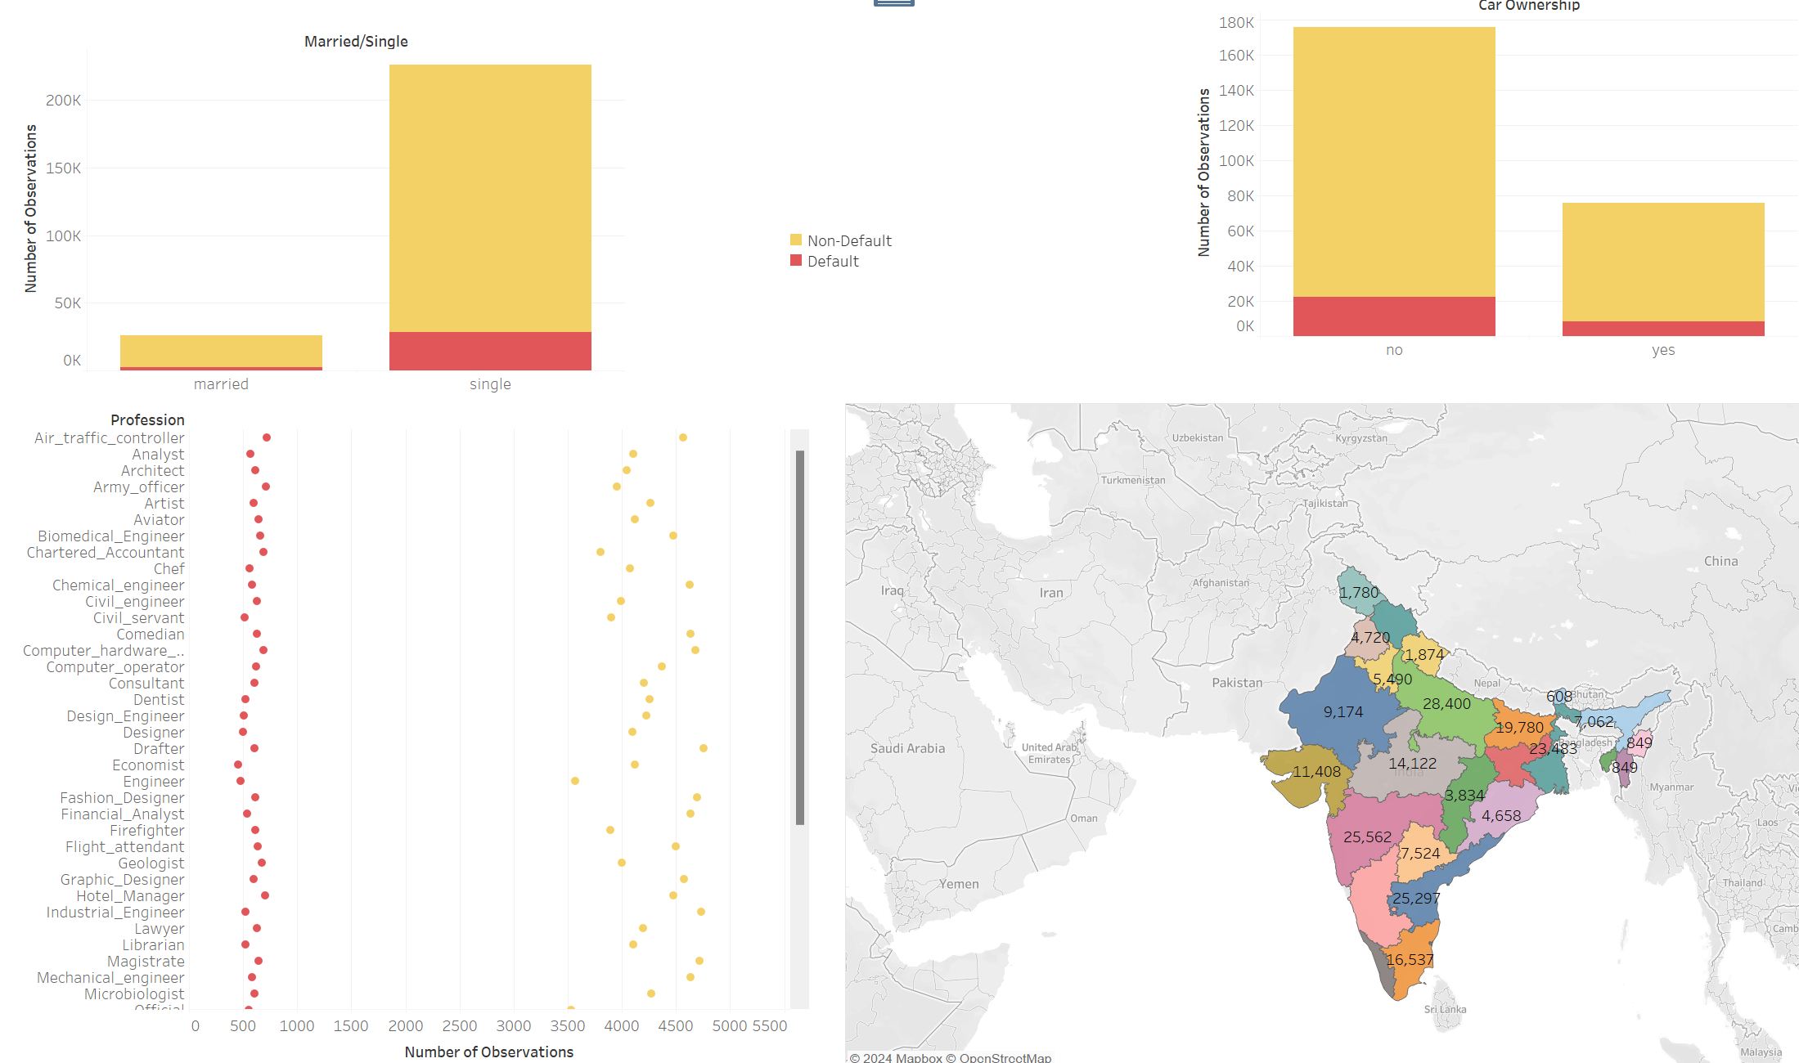
Visualizing Categorical Variables
Here can clearly see that the data is imbalanced with respect to the “Risk_Flag” indicator

Slide 12
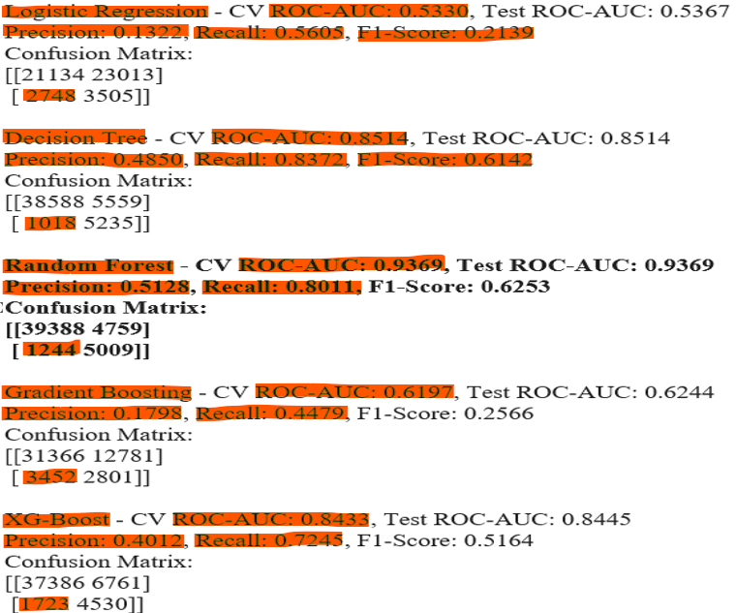
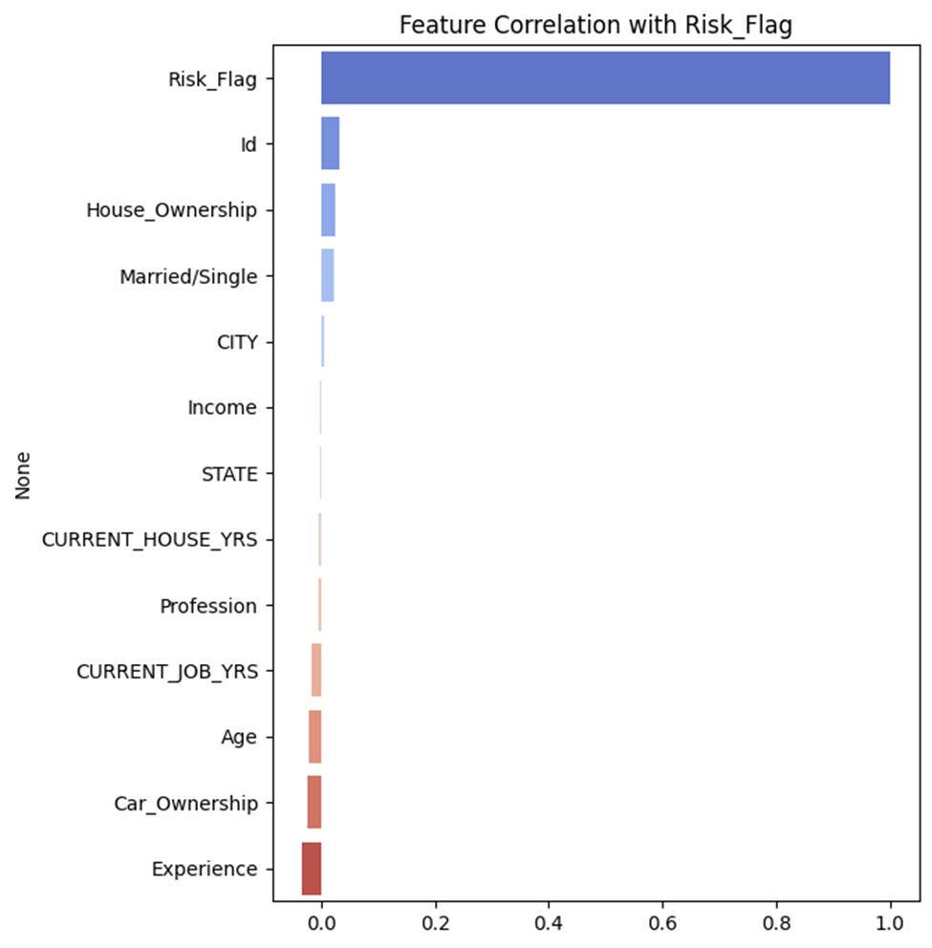
Initial Model Evaluation and Metrics
First Pass
We can see that based on accuracy the Random Forrest Classifier does well
XG-Boost is tried again later on as it to is a tree-based classifier

Slide 13
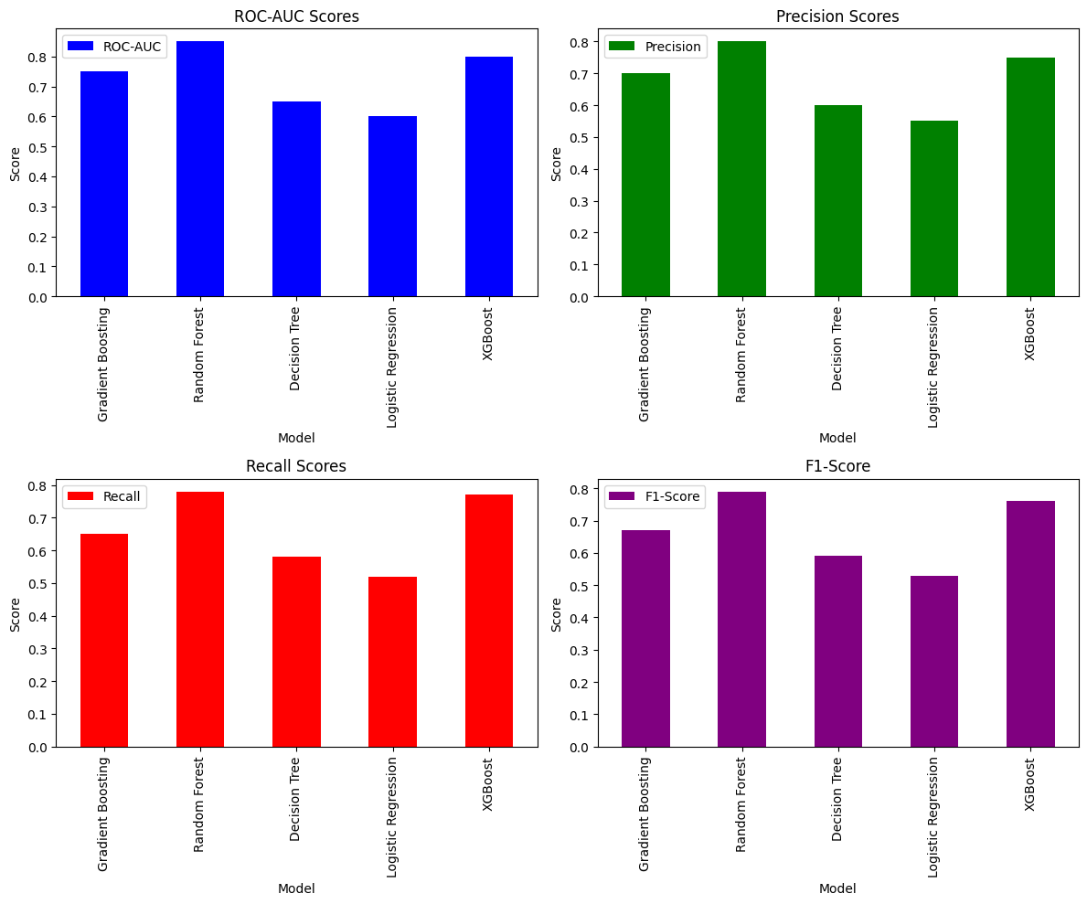
Model Evaluation and Metrics Contd.

Slide 14
Improvements
Feature Engineering and Encoding:
Create a derived field called “Location” as we all columns equally important
“Bangalore[12]” + “_Karnataka” = “bangalorekarnataka”
One Hot Encoded low categorical cardinality variable (with unique values < 3)
“Married/Single”/ “Car_Ownership”
Binary Encoded when categorical cardinality >=3 to prevent increased dimensionality
“House_Ownership”
Nominal Label Encoding columns which have not particular ordering in them
“Profession”/ “Location”
Dropped unique identifiable columns such as “Id”, “City”, “State” to reduce the dataset size from 252k →43k
Over Sampling the minority class using ADASYN and Random Over Sampler

Slide 15
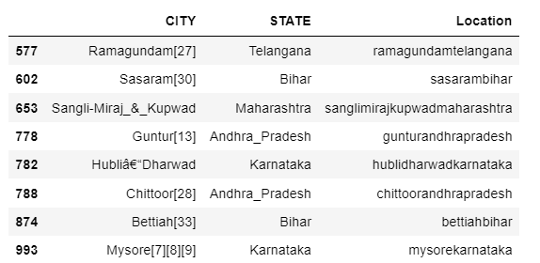
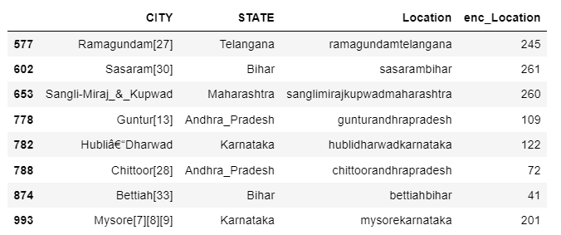
Encoding for Categorical Features
Nominally encoded the new derived “Location” column using Label Encoder as this is a high cardinality categorical variable and would increase dimensionality
Cleaned and pre-processed the “City” and “State” by removing special characters like [,_-] and digits we created a derived field called “Location”

Slide 16
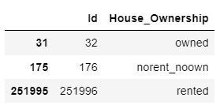
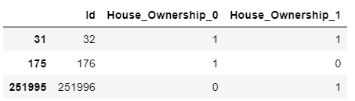
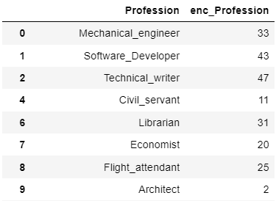
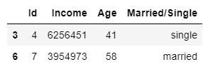
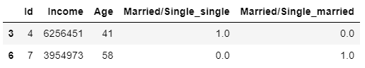
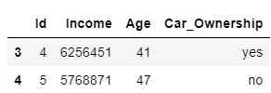
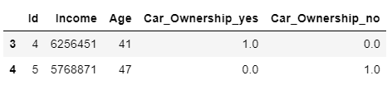
Encoding for Categorical Features Contd.
Binary Encoded the “House_Ownership” to reduce dimensionality
2 columns instead of 3
One Hot Encoded the “Car_Ownership” & “Married/Single” columns. This helps sensing patterns by classification algorithms
Encoded the “Profession” column using Label Encoding due to high categorical cardinality

Slide 17
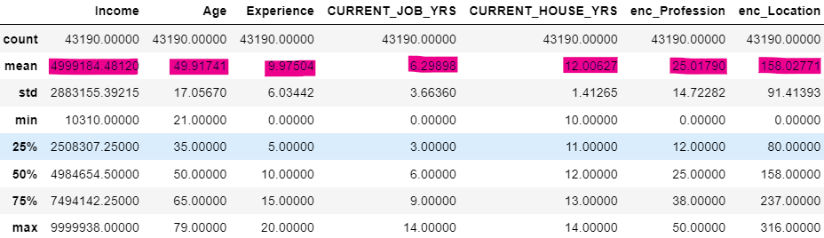
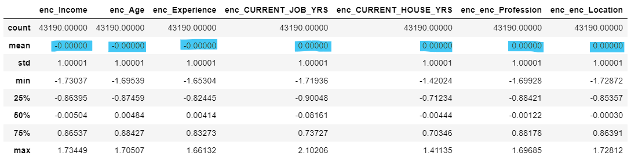
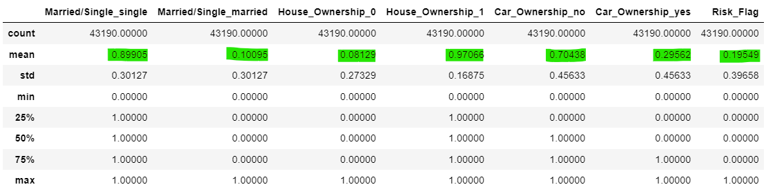
Scaling Numerical Features
After scaling the columns, we get the below see descriptive statistics
We can see that the mean for some columns such as “Income” and “enc_Location” have a very large mean value which affects the uniformity of scale, algorithm sensitivity and in turn penalizes the magnitude of coefficients

Slide 18
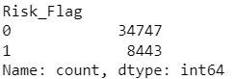
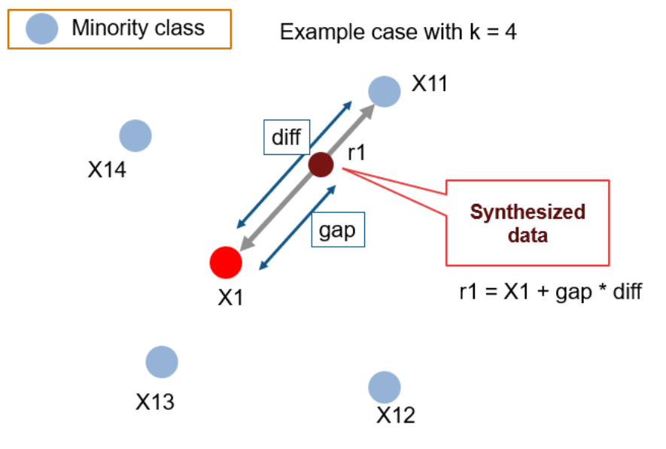
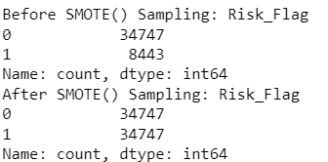
Dealing with Imbalanced Data
Original Distribution
Synthetic Minority Over-Sampling Technique (SMOTE): Uses K-Nearest Neighbor's to synthetically generate new instances of the minority class.

Slide 19
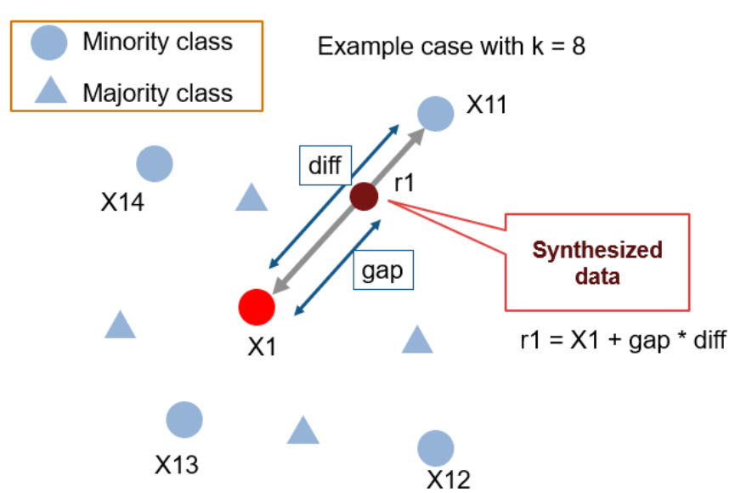
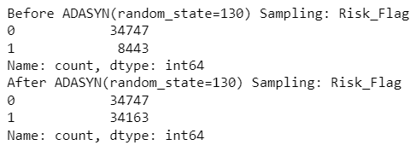
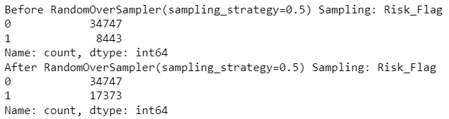
Dealing with Imbalance Data Contd.
Adaptive Synthetics Sampling Approach (ADASYN): Over Sampling technique that generate new instances based on adaptive density-based distributions in other words generating new instances of the minority class using data points which are on the classification line thus giving the model the ability to learn more skill fully.
Random Over Sampling: Picks minority samples at random with replacement.

Slide 20
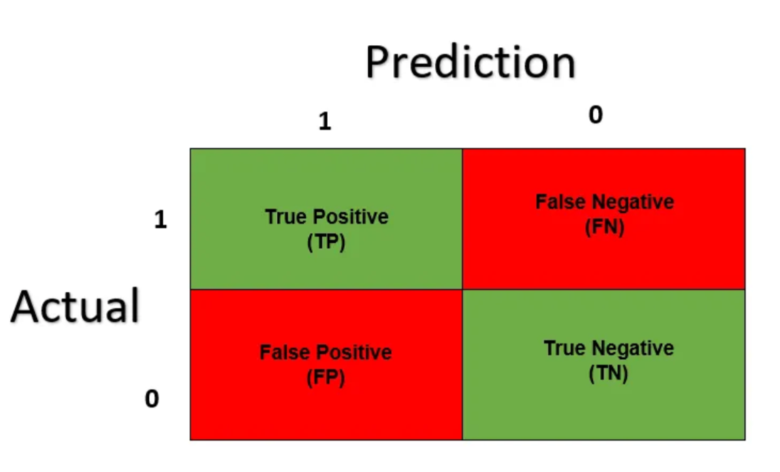
Model Evaluation and Metrics
P.S:-
Here we are predicting a Risk indicator of Loan Defaulter’s and Non-Defaulters. As a financial institution disbursing loans we will need to minimize or completely nullify “False Positive’s” as this would mean miss-classifying a customer as a non-defaulter when in reality they are. Having miss classified “False Negatives” are a small price to pay in comparison as this means we have incorrectly classified a customer as a defaulter when in reality they are not, this means we will lose the interest rate of the customer rather than lose the disbursed loan amount.

Slide 21
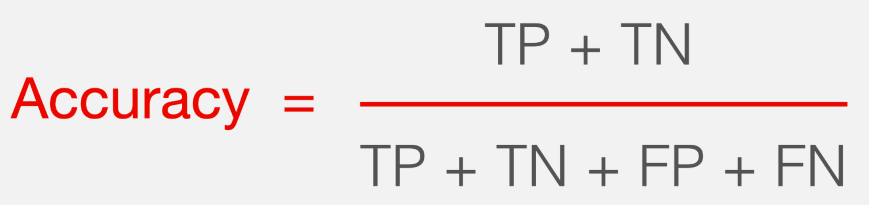
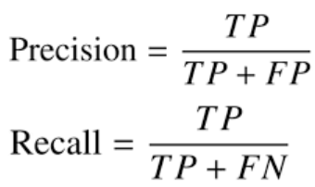


Model Evaluation and Metrics Contd.
Best Classifier

Slide 22
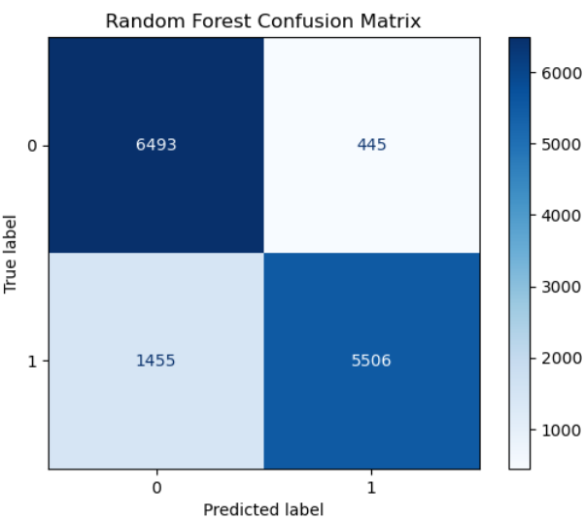
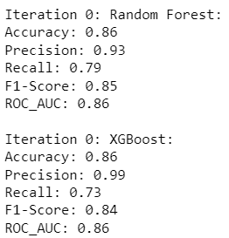
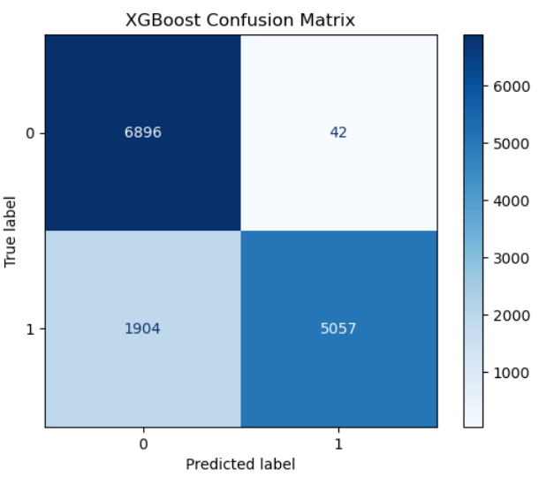
Model Evaluation and Metrics Contd.
SMOTE

Slide 23
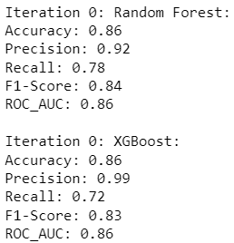
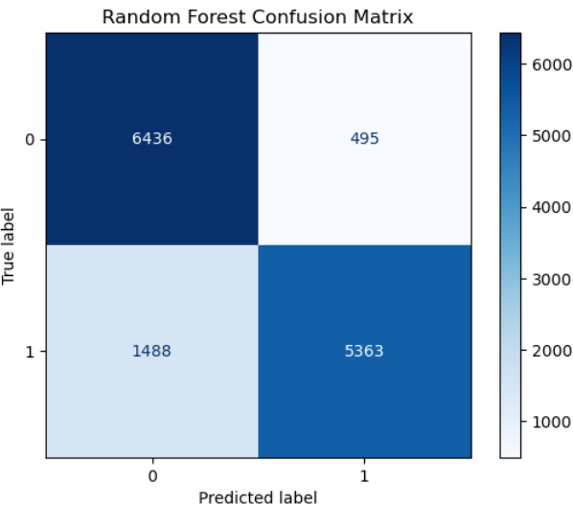
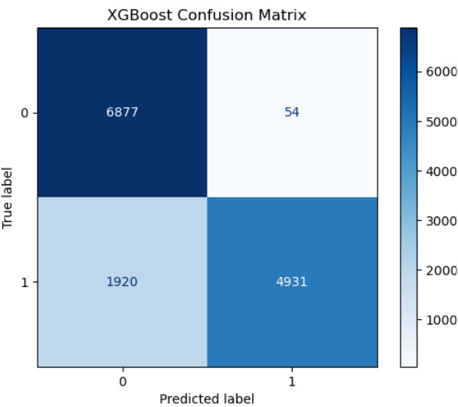
Model Evaluation and Metrics Contd.
ADASYN

Slide 24
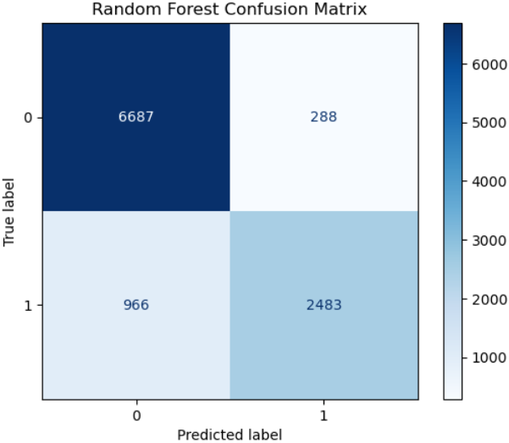
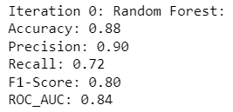
Model Evaluation and Metrics Contd.
Random Over Sampling

Slide 25
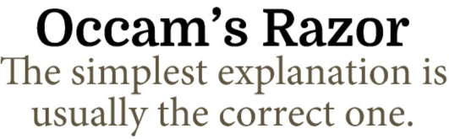
Conclusion
As established earlier on in the slides, the dataset is non-linear and imbalanced
To overcome non-linearity, we have used tree-based classification algorithms such as Random Forrest and XG Boost
To balance the dataset, we have oversampled the minority class rather than under sample the majority class to prevent information loss. Here we see that the most basic oversampling method such as Random Over Sampling is proven to be best rather than synthetic data generation methods
During model building phase, we made sure to reduce the number of “False Positives” as much as possible
Based on classification metrics we have established that using Random Over Sampling with a Random Forrest Classifier gives us the best model

Slide 26
Future Improvements
Parameter Tuning the Random Forest Model
Parameter Tuning the XG-Boost Model and re-iterate
Use unsupervised learning methods like Density Based Spatial Clustering (DBSCAN) to see if the data can be split into two separate clusters based on Risk Indicator
This will give us a deeper insight into how classification accuracy can be improved further
Use probabilistic metrics for imbalanced data classification like Log Loss and Bier Score

